Slide 1

Educare
.

Slide 2
Project context:-
Effective student and teacher interaction.
Here students can also create a crew for more information and for better interaction between themselves
Can give views or response to the question raised by any other student and also teachers.
Can hire tutor in less price.

Slide 3
Project Context:-
Can get the materials and solution for free.
Enhancing the English speaking capacity by it’s features.
Broadcast the diff workshops and tech talks .

Slide 4
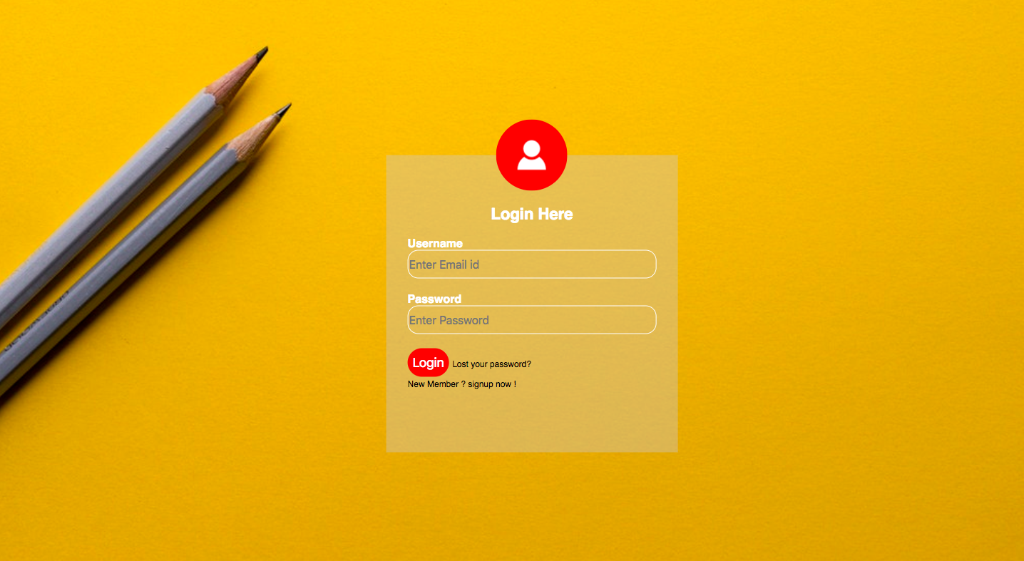
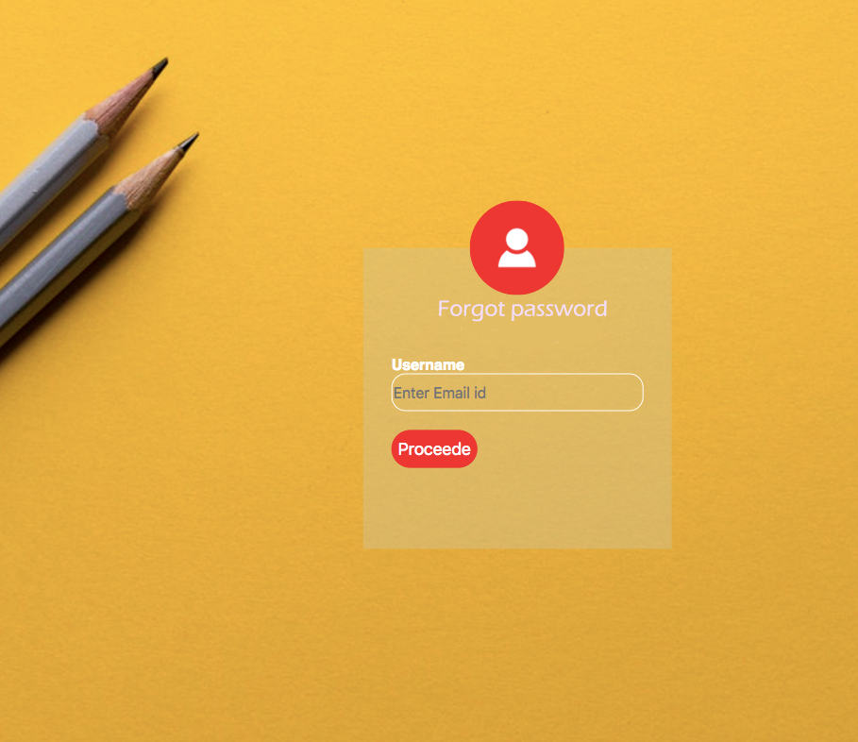

Slide 5
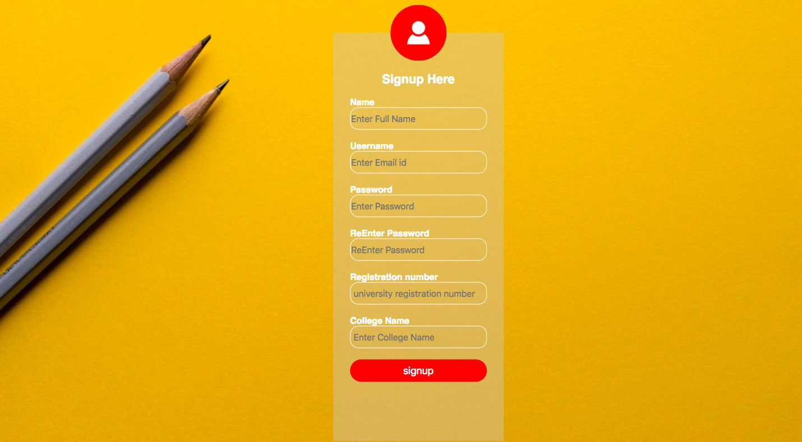

Slide 6
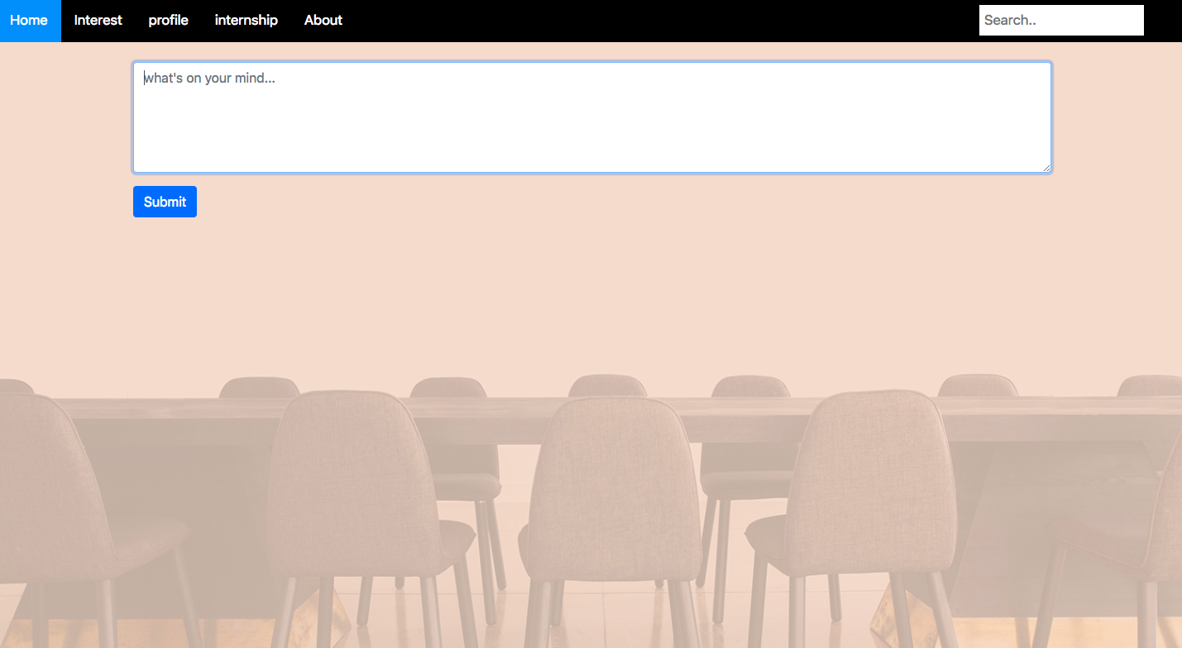

Slide 7
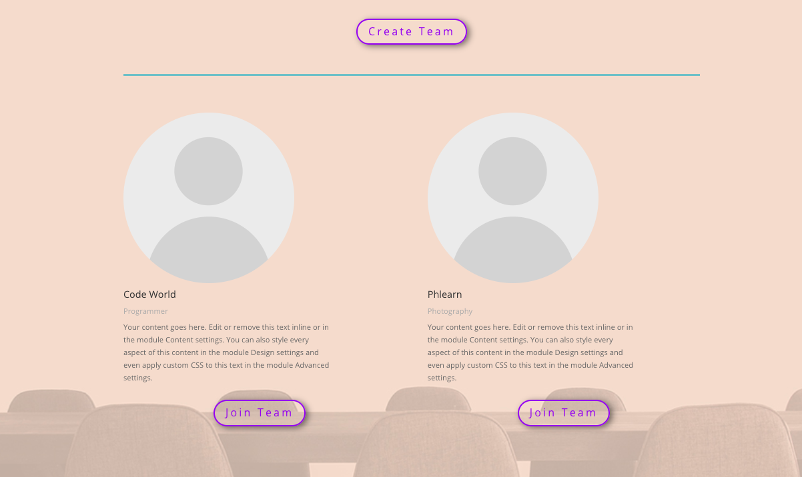

Slide 8
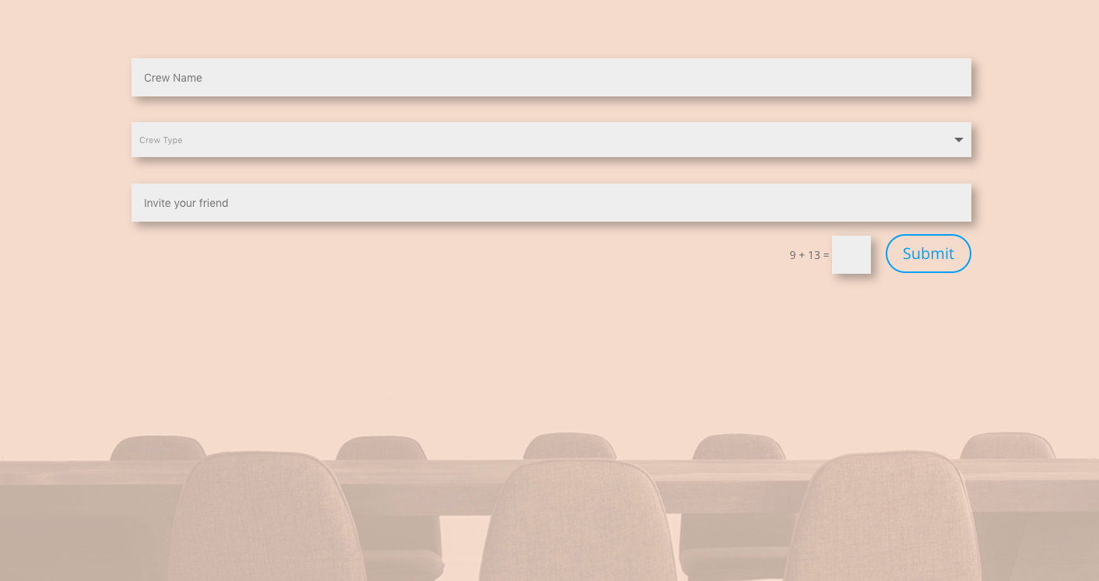

Slide 9
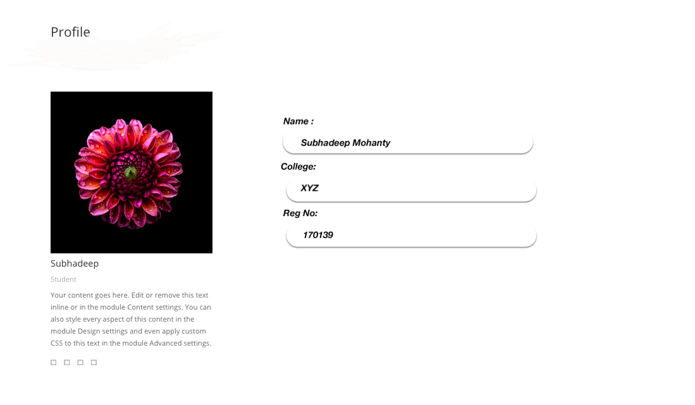

Slide 10
SIGNIIFICANCE OF PROJECT:-
It is an Online discussion forum where the teachers and the students can interact with each other and can clear all the doubts .If required then students can also avail the notes from the lecturers.
Here students can also create a crew for more information and for better interaction between themselves.
Here the students can also give their views or response to the question raised by any other student, and also they can interact with teachers for their required answer , and another basic problem now a days maximum students are facing is that speaking English , here there is an platform that the students will be provided with a calling service ,and their identity will be confidential while calling.
The login participants may apply and enhance their programming skills . It will also make them appreciated the importance of the system more .

Slide 11
Here this platform will provides the students to interact with the other students and the teachers without any hesitations and can ask for also notes and materials.
Here the student participants can join the teacher’s crew, on which topic they are really interested or any answer what may be they are searching for .
Here also they are provided with the voice calling features which can improve the speaking capacity of the students and also their confidence level..
Here the process:
The user will give a nickname of them and the nickname will be show and their actual id will be kept as private and they will press the call button and then at that time who is online randomly the call will connect anyone of them.
The receiver may be a student or may be a teacher they can interact with each other and their identity will kept confidential.
And in this way the confidence level will increase.
This features is also avail for asking question when the receiver permit him/her, in this way also their communication skill will be better and also they can get their required result.

Slide 12
